Slide 1









NOTICE: Proprietary and Confidential This material is proprietary to Geocent. It contains trade secrets and confidential information which is solely the property of Geocent. This material is solely for the Client’s internal use. This material shall not be used, reproduced, copied, disclosed, transmitted, in whole or in part, without the express consent of Geocent. © 2009 All rights reserved
Centered on Solutions
Sprint Artifact
GSA 18F BPA Agile RFQ
Sprint: Stabilization Review
July 1, 2015

Slide 2
Agenda
Goals/Dependencies/Definition of Done
Stories
Issues (Open/Closed)
Demonstration
Sprint Schedule
Retrospective
Plan Ahead to Delivery

Slide 3
Sprint Stabilization
Goals:
Clean up issues (GitHub), finish stories (ScrumDo), and stabilize application
Dependency:
None
Definition of Done:
Issues completed in GitHub
Pass testing in Integration branch/CI
Validated Unit Tests
Validated End-to-End Tests
Validated User Acceptance Testing
Validated Usability Testing

Slide 4
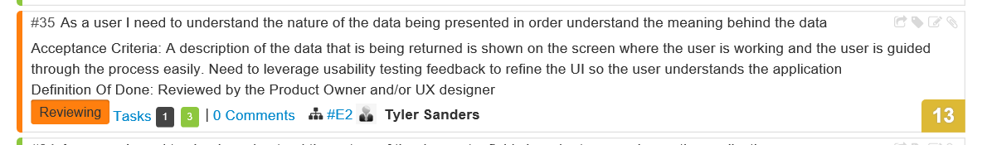
Sprint Stabilization Stories
Story from Sprint 3 needs code review to close. Randy will work.
https://www.scrumdo.com/projects/project/18f-ads-prototype/iteration/128771

Slide 5
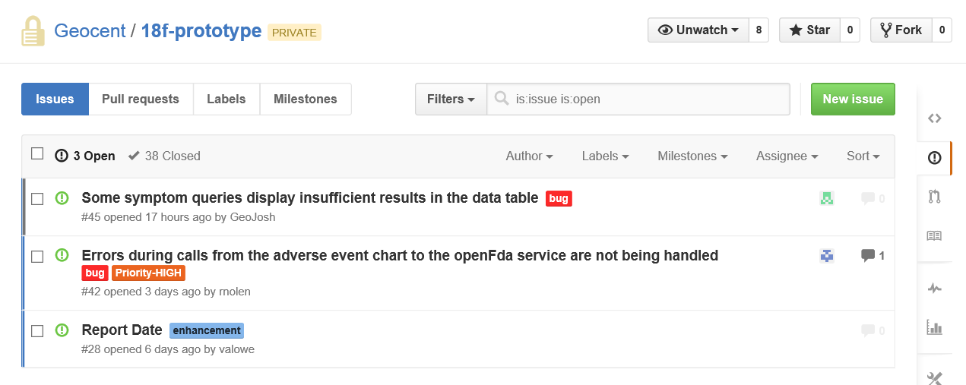
Sprint Stabilization Issues - Open
Symptoms Query – limitations on the ABI resolution, Josh will close with an explanation of what happens.
Errors – Keith will test and determine if any further action is needed.
Report Date – not a priority
https://github.com/Geocent/18f-prototype/issues

Slide 6
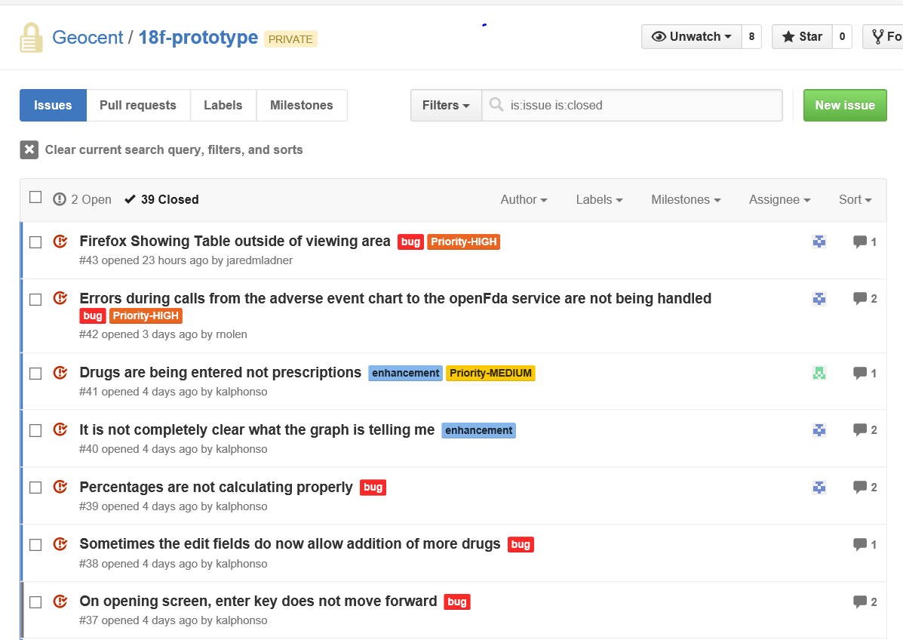
Sprint Stabilization Issues - Closed
https://github.com/Geocent/18f-prototype/issues
Product Owner requested adding all Closed Issues to the Sprint Review slide deck.
List includes closing of Symptoms issue discussed and closed during Sprint Review.

Slide 7
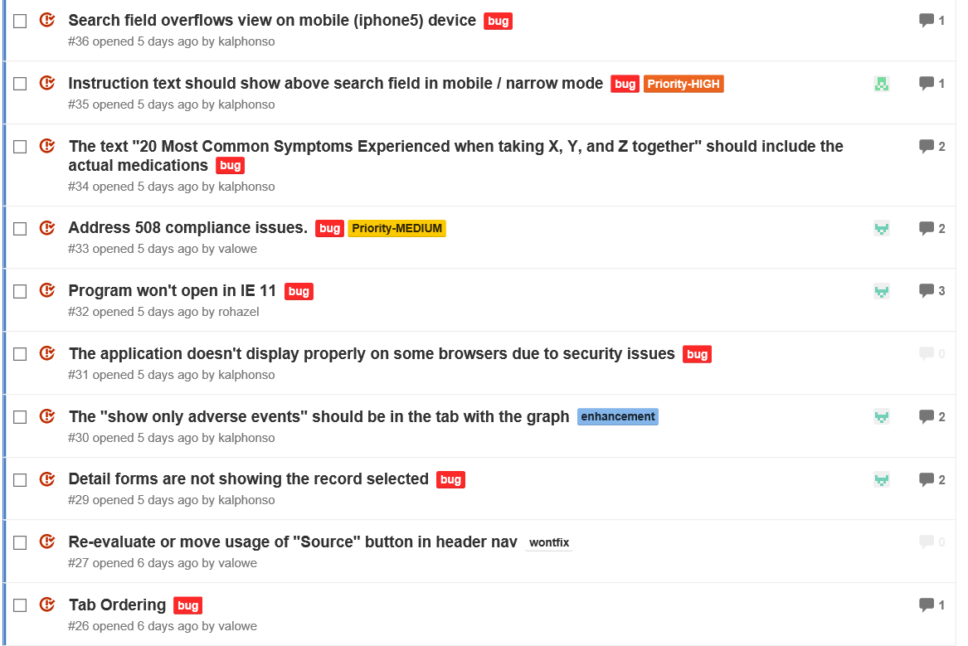
Sprint Stabilization Issues - Closed
(Continued)

Slide 8
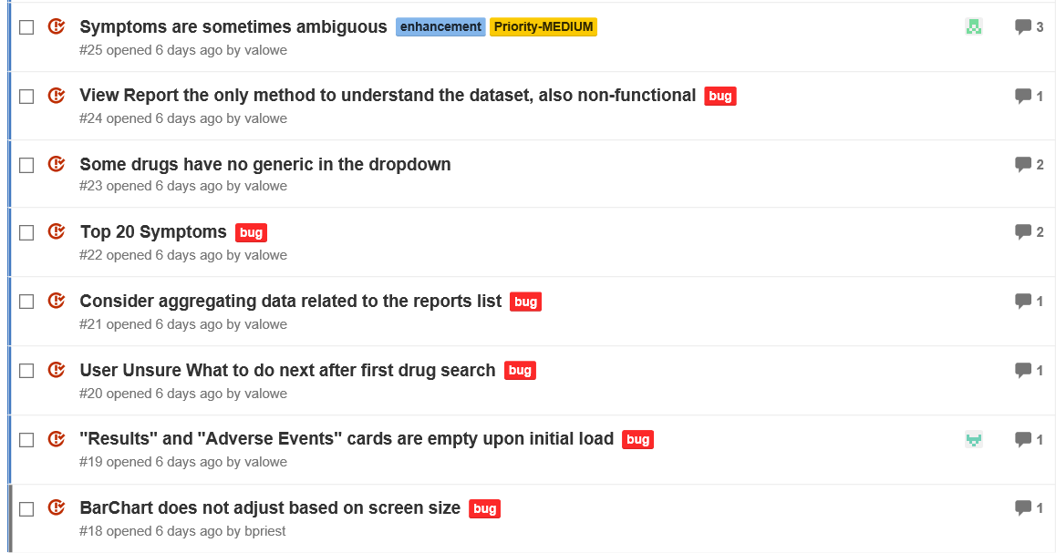
Sprint Stabilization Issues - Closed
(Continued)

Slide 9
Sprint Stabilization: Demonstration
Issue that graphic labels display if No Results are found – continue to get message where graph goes, still has the links to show the graph – we need to hide all the content – Keith will create a new issue.

Slide 10
Sprint Schedule
Sprint 0 – Capture Sprint
6/17/2015
Sprint 0 Planning: 6/17
Sprint 0 Review: 6/18
Sprint 1 – Architecture, Development, Testing
6/18/2015 – 6/22/2015
Sprint 1 Planning: 6/18
Sprint 1 Review: 6/23
Sprint 2 – Finalize Product, Final QA Testing, User Testing
6/23/2015 – 6/24/2015
Sprint 2 Planning: 6/23
Sprint 2 Review: 6/25
Sprint 3 – Usability Enhancement
6/25/2015 – 6/29/2015
Sprint 2 Planning: 6/25
Sprint 2 Review: 6/29
Sprint Stabilization
6/30/2015
Deliver
7/7/2015
Completed
Completed
Completed
Completed
Completed

Slide 11
Sprint: Stabilization Retrospective
What went well?
Doing dev – like the way unit test is set up and showing errors quickly via email notification as soon as errors are found by the unit test
Stories/features reviewed immediately, PO reviews immediately, no gap to feedback, as soon as you finish it, it is reviewed and responded to by testers
Fast delivery method of software
Rapid feedback, impressive
Able to see results of development through CI environment immediately and able to test right away
Team of people troubleshooting road blocks and issues so there was a constant progression and no stall out – this was impressive
What did not go well?
Sprint was fast enough to where all things went well
What would you change?
longer sprints

Slide 12
Sprint: Delivery Plan Ahead
ID high priority items – one person to work
Shore-up documentation
Another round of usability testing – with same and new testers
Issues identified from others working with it – Keith will log the issues and identify the ones that need fixing, misspelling,
Project Lead, Product Owner, and Scrum Master will figure out plan today and will report back to team in terms of how we will proceed to delivery on July 7.
Latest version needs to be in production – Jared will push over after meeting
Made public next Wednesday
Review justifications in Pool 1 and 2 tables
ScrumDo - needs full export
Description 750 words
Aaron – unit test for pie chart stories – finished today, need to see coverage
Version label – 1.0 upon delivery
Keith will contact via email and Skype chat to provide directions to finish up small issues, no new features will be added.

Slide 13

Questions

Slide 14


